Slide 1
Ending Silence on Misogyny, Harassment, and Violence
“
Exploring Causes and Solutions

Slide 2
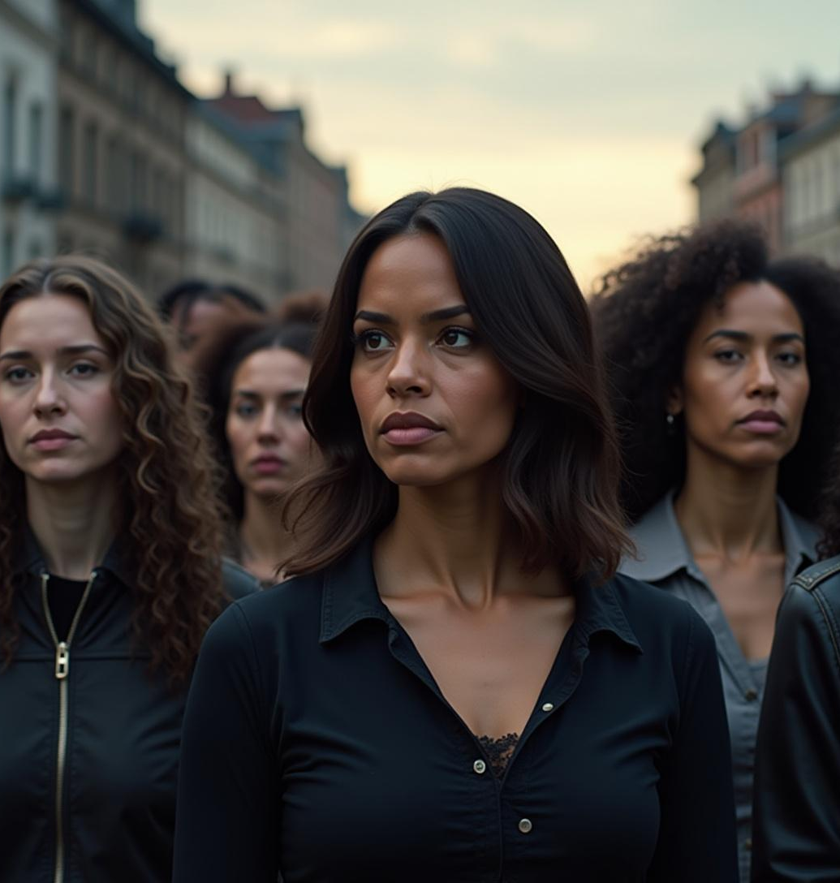
Introduction
As we’ve just heard, misogyny isn’t always loud or obvious. Sometimes, it hides in silence, in neglect, or in the way women’s needs are ignored.

Slide 3
"Note: The video has private access and is intended for classroom presentation only, as it contains personal/private stories." The video: https://drive.google.com/file/d/1_euct4F-STRfaGZL9FpFsMtAkesjd8_Y/view?usp=sharing

Slide 4
These stories, and these reflections, show us that change is possible—but only if we are brave enough to speak, to listen, and to act.”

Slide 5
Main Causes of Harassment and Violence
“

Slide 6
Main Causes of Harassment and Violence
Cultural Normalization Many cultures normalize “small” acts of sexism, like catcalling, or objectifying women in films and ads. Over time, this desensitizes society and makes larger acts of violence seem less shocking.
Toxic Masculinity Boys are often taught that "being a man" means being aggressive, emotionless, and in control. This mindset leads some men to believe they deserve authority over women.
Weak Laws & Lack of Accountability In many places, victims are blamed, harassers go unpunished, or reporting systems are slow . This makes people afraid to speak up—and makes abusers feel untouchable.

Slide 7
Main Causes of Harassment and Violence
Power Imbalance
Silence & Social Complicity
even people who don’t agree with the abuse stay silent. Friends, family, teachers, or bystanders may not speak up, thinking it’s "not their problem." This silence protects the abuser.

Slide 8
Solutions for Harassment and Violence
“

Slide 9
Real Solutions to Harassment & Violence
The Change Begins With Us “Be the change you expect from the world.”
Education That Builds Respect - Teach respect, empathyfrom a young age - Support victims. Listen without judgment. Believe them.
Strong Laws & Safe Systems - No tolerance for violence
Normalize Speaking Up
Provide quick-access tools for safety

Slide 10

Conclusion
Creating a safe and respectful environment starts with awareness, accountability, and action.
Harassment and violence thrive in silence — change begins when we choose to speak up and stand together.

